Slide 1


Slide 2
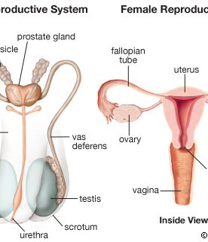
Human reproduction system

Slide 3
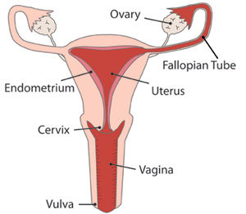
Female Reproductive system

Slide 4
OVARY
Produces female cells [OVA]
This is known as ovulation and takes place after every 28 days

Slide 5
OVIDUCT [FALLOPIAN TUBE]
It is a passage through which the eggs passes from the ovary to the uterus
It is where fertilization takes place

Slide 6
UTERUS/WOMB
Fertilized egg [ZYGOTE] develops into an embryo that attaches itself to the wall of the uterus [uterine wall]
This is called implantation.
The embryo develops into foetus which remains in the uterus throughout the gestation period

Slide 7
CERVIX
It is the lower part of the womb
The cervix muscle relaxes during child birth to allow the baby to be born

Slide 8
THE VAGINA
It is called the birth canal
Allows for the passage of the baby during birth

Slide 9
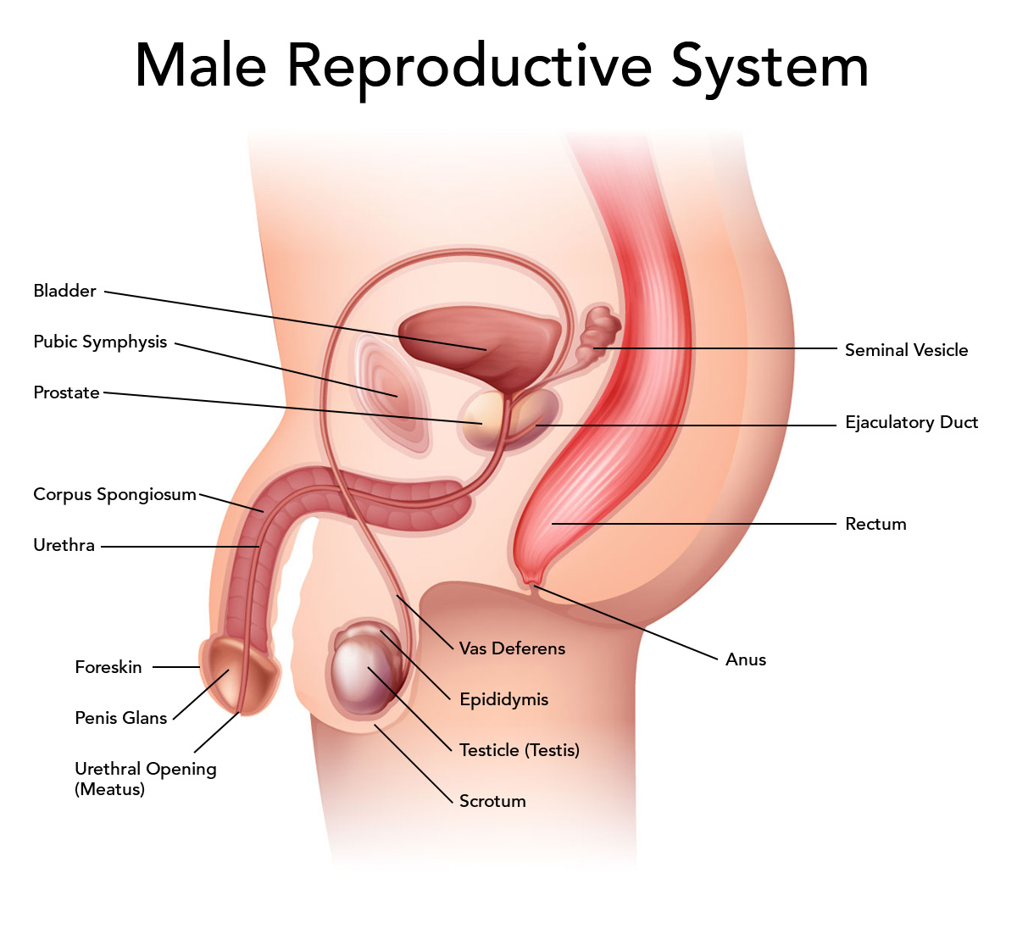
THE MALE REPRODUCTIVE SYSTEM

Slide 10
MALE PARTS AND THEIR FUNCTIONS

Slide 11
PENIS
It deposits sperms into the vagina during sexual intercourse
Allows passage of sperms and urine

Slide 12
Testis
Produces the male sex cells. They are enclosed in the scrotum

Slide 13
Urethra
Long tube through which urine and sperms pass to the outside

Slide 14
Sperm Duct
Are tiny tubes that connect the testis to the urethra

Slide 15
Epididymis
Stores sperms

Slide 16
ADOLESCENCE
Is a stage between childhood and adulthood
A person going through adolescence is called an adolescent
It occurs between the age 12 and 18 years

Slide 17
Physical Changes During Adolescence
Physical changes in girls
Physical changes in boys
Girls increase in size
Breasts appear
Hips enlarge
Ovaries mature and start releasing the egg
Menstruation begins
Face becomes smooth
Hair grows under the armpits and on the pubic area
Pimples may appear
Testis mature and start producing sperms
Wet dreams
The voice breaks
Hair grows on the chin(beard),cheek and pubic area
Muscles increase in size and body weight increases
The chest and shoulder widens
Pimples may appear on the face

